Slide 1
Retail Business Performance & Profitability Analysis
Author – Aman Dikshit
Date – August 2026
Tools used – SQL, Python (Pandas, Seaborn), Tableau

Slide 2
A concise overview of the project’s purpose and findings
This analysis examined retail transactional data to identify profit‑draining categories, seasonal sales behaviour, and the impact of returns. Using SQL, Python, and Tableau, I uncovered key drivers of profitability and developed actionable recommendations for inventory and discount strategies.

Slide 3
Methodology
SQL: Data cleaning, profit margin calculations, return counts.
Python: Correlation analysis, inventory turnover insights.
Tableau: Interactive dashboards for profitability, regional sales, and returns.

Slide 4
Key Insights
Profit margins vary widely across sub‑categories; Furniture and Office Supplies show weaker margins compared to Technology.
Returns are concentrated in specific categories, reducing overall profitability.
Discounts negatively correlate with profit, confirming that aggressive discounting erodes margins.
Seasonal peaks in sales (holiday months) highlight opportunities for targeted promotions.
Central region contributes strong sales but moderate profits, suggesting regional efficiency gaps.
Refunds are heavily concentrated in a few categories, pointing to product quality or customer satisfaction issues.
Inventory turnover is slower in Furniture and Office Supplies, indicating overstock risks.

Slide 5
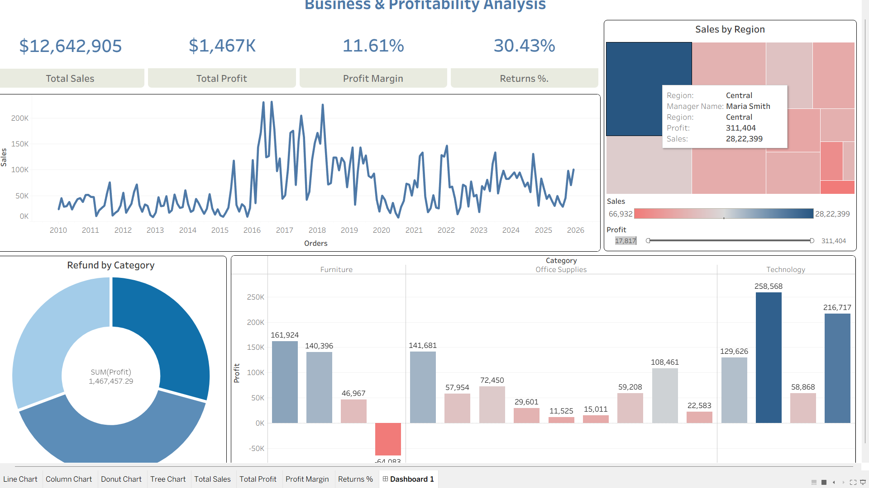
Dashboard Screenshot: Overall KPIs (Sales, Profit, Margin, Returns %).

Slide 6
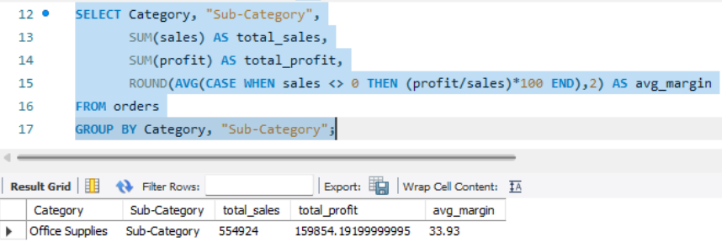
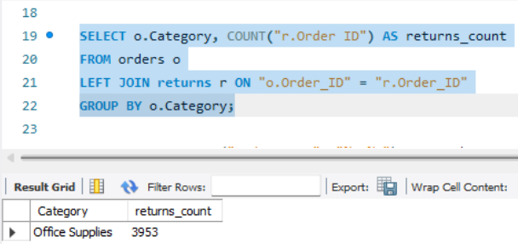
SQL Result Table: Returns by category / sub‑category.

Slide 7
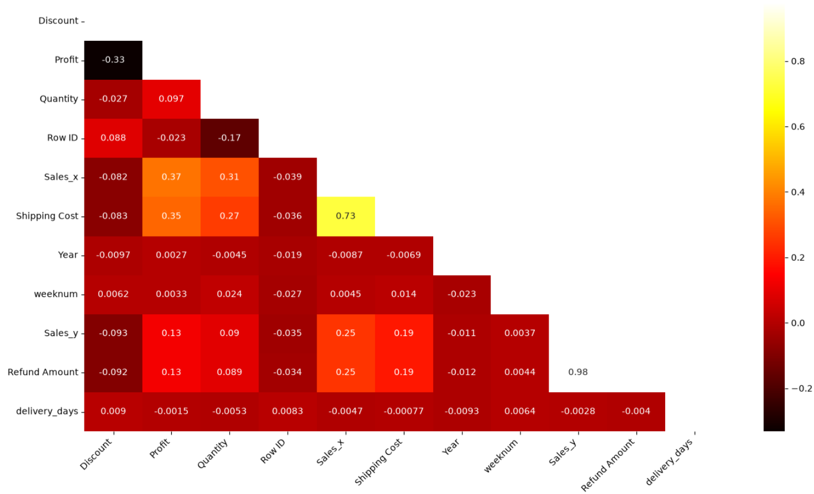
Python Output: Correlation heatmap showing discount vs profit relationship.

Slide 8
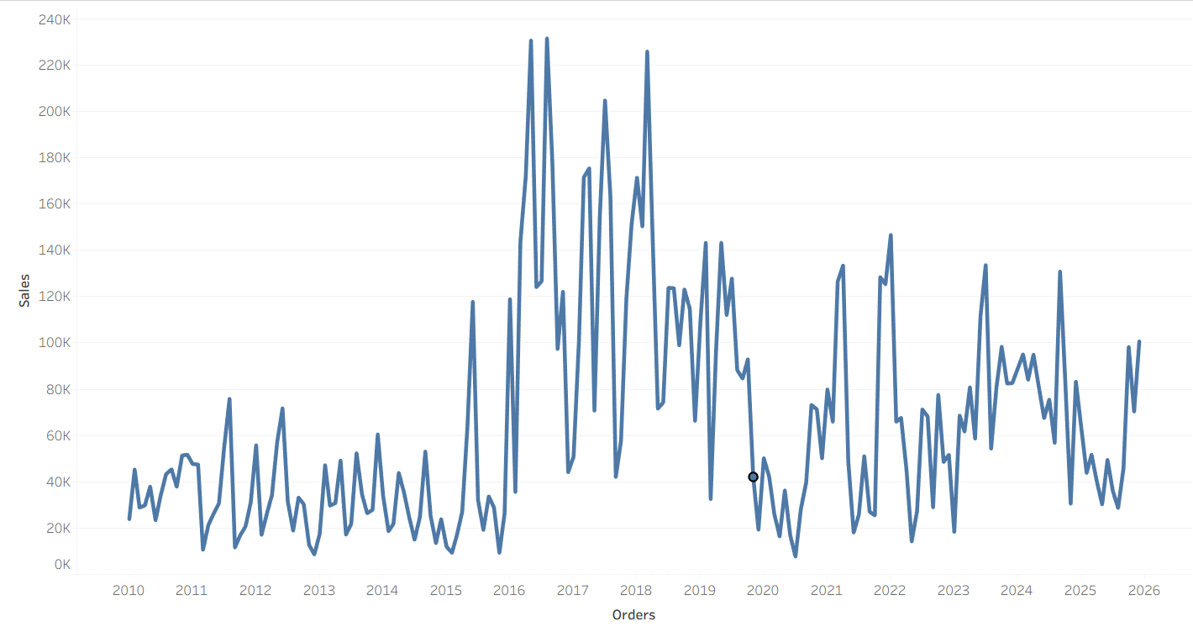
Tableau Chart: Monthly sales and profit trends.

Slide 9
Recommendations:
Reduce discounting in low‑margin categories.
Improve return policies and product quality checks in Furniture.
Optimize inventory turnover for slow‑moving categories.
Focus marketing efforts on seasonal peaks to maximize profitability.

Slide 10
Conclusion
This project demonstrates how combining SQL, Python, and Tableau can uncover actionable insights in retail data. By addressing return rates, discount strategies, and inventory turnover, businesses can significantly improve profitability and operational efficiency.

